Slide 1
K Mode clustering
One of the way to represent clusters as centroid i.e. centroid of the cluster-c is c-centroid. This
works well if the clusters are of the hyper-spherical shape.
For other shapes, one of the other ways is ‘frequent value’ to represent a cluster. i.e. mode

Slide 2
If dataset is categorical form, clustering the categorical variables; we use K mode clustering
Algorithm,
This algorithm defines clusters, based on the number of matching categories between data
points.
Simple matching dissimilarity measures (i.e. mismatching) instead of Euclidian distance measure
Mode for cluster centre ….. Instead of Mean
Frequency-based method to update the modes in each iteration

Slide 3
K-mode clustering algorithm for clustering categorical data and it is used to partition a dataset into a specified number of clusters, where each cluster is characterized by a mode, which is the most frequent categorical value in the cluster.
To calculate the new centroid for the cluster, we will calculate the mod of the values in each feature of the data points. Here, the mod is the value with the most frequency.

Slide 4
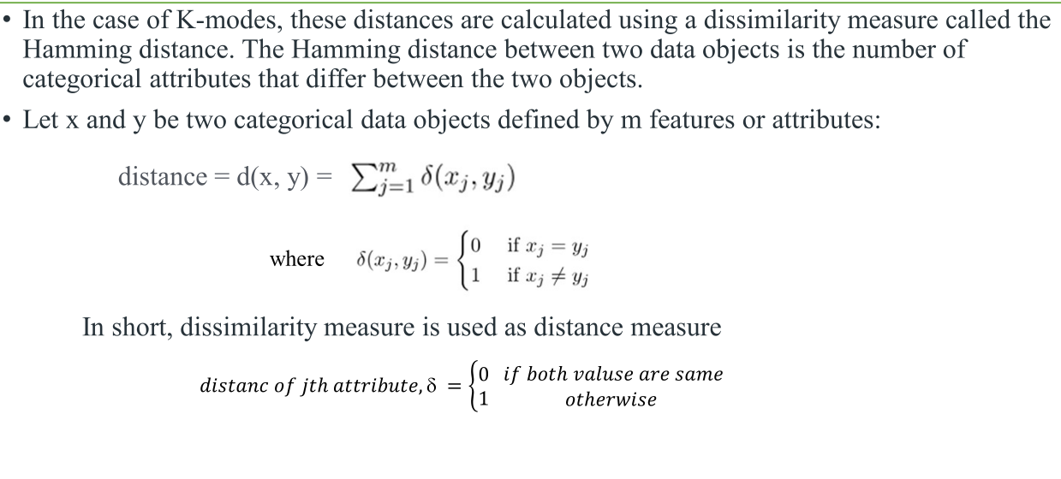

Slide 5
K mode clustering algorithm
1.Select K observations at random and use them as leaders/clusters
2.Calculate the dissimilarities between observation and each cluster and assign the observation
to its closest cluster
3.Define new modes for the clusters
4.Repeat 2–3 steps until stopping criterion.

Slide 6
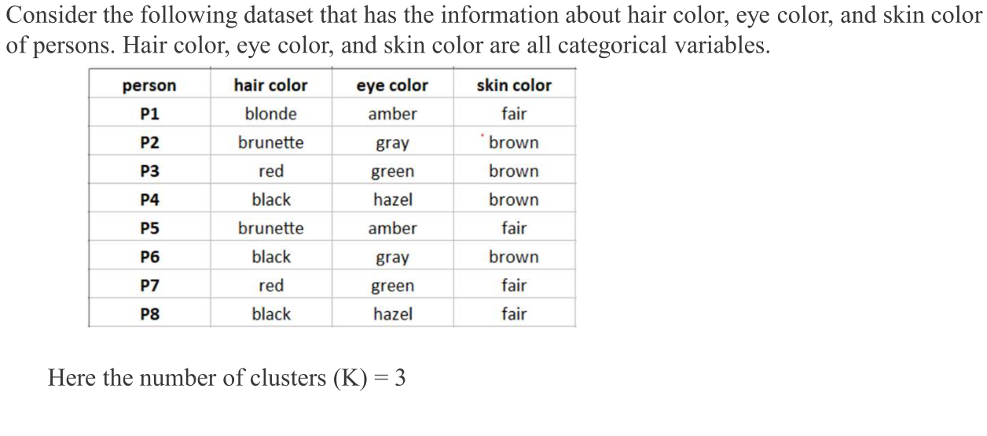

Slide 7
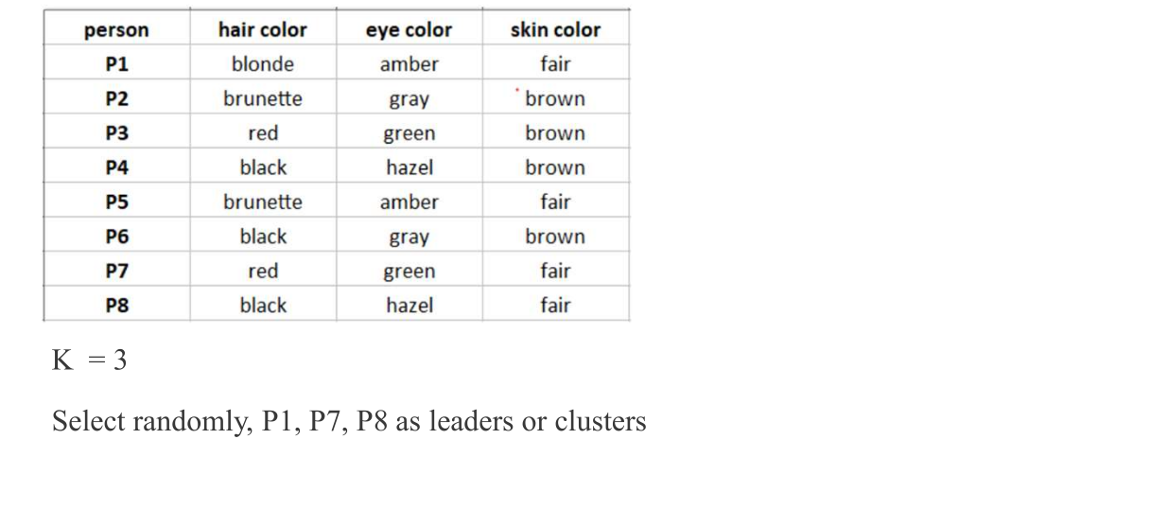

Slide 8
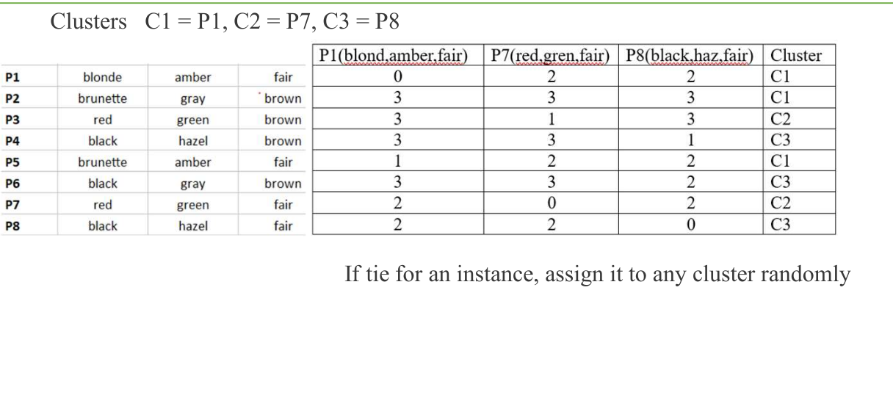

Slide 9
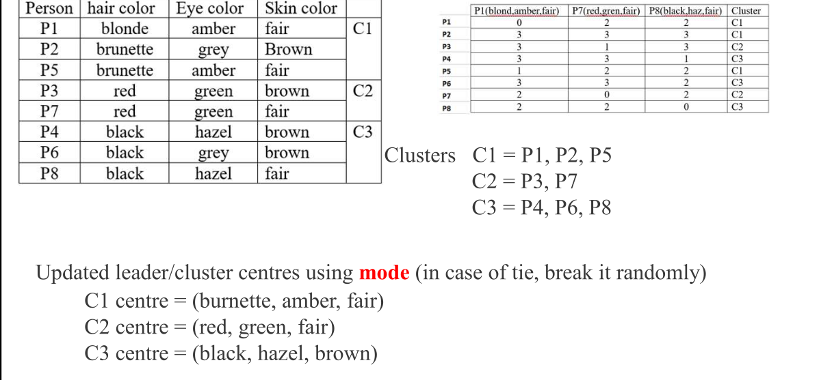

Slide 10
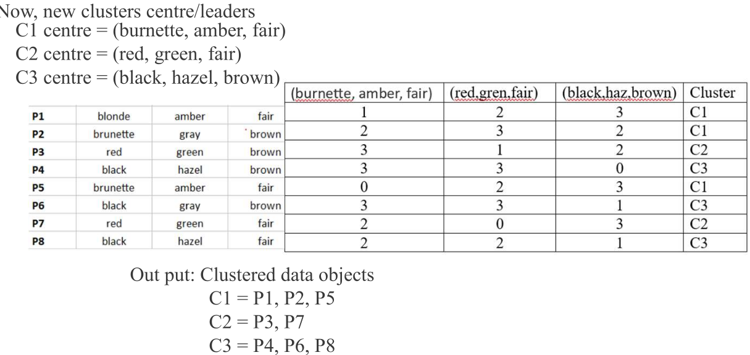

Slide 11
Advantages of K-Modes Clustering
K-Modes clustering is an iterable algorithm. It doesn’t use any advanced mathematical constructs. Hence, it is easy to understand and implement the K-modes clustering algorithm.
K-Modes clustering is a scalable algorithm. You can use it for a small dataset as well as a large dataset having millions of entries.
The k-Modes clustering algorithm is guaranteed to give us results. It guarantees convergence. Thus, we will get the result of the execution of the algorithm for sure.
K-modes clustering doesn’t apply to a specific domain. As long as you have a dataset having categorical attributes, you can use the K-Modes clustering algorithm to partition the dataset into different clusters.
The K-Modes clustering algorithm allows you to choose the initial centroids. You can warm-start the choice of centroids in a manner that suits the distribution of values in the dataset to minimize computation.

Slide 12
Disadvantages of K-Modes Clustering
In K-modes clustering, we don’t know the number of clusters that are required to partition the data. We need to try different values of K and decide the best k for clustering.
The computation required while clustering is hugely dependent on the choice of initial centroids. Hence, we need to be extra careful while choosing the initial centroids.
The maximum dissimilarity score between two data points is equal to the number of features in the dataset. Hence, it is very likely that a data point has the same dissimilarity score for two or more centroids. In such a case, we need to define a mechanism to select the centroid to which the data point will be assigned.
The final clusters in K-Modes clustering are heavily dependent on the initial centroids.

